Slide 1
Ten Best Practices for Academic Success
Bob Brown, Ph.D. College of Computing and Software Engineering Thanks to Dr. Bob Harbort for invaluable suggestions and discussion.
Copyright © 2020 by Kennesaw State University
Notes:
Note: A bullet in the speaker notes indicates click for animation effect.
[Pause 8 seconds for intro music]

Slide 2
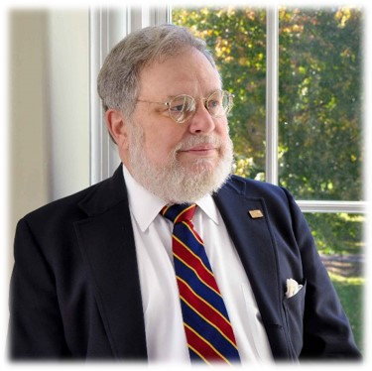
Bob Brown, Ph.D. College of Computing and Software Engineering Thanks to Dr. Bob Harbort for invaluable suggestions and discussion.
Copyright © 2020 by Kennesaw State University
Notes:
Hello! I’m Bob Brown. I’m retired, but I taught at Southern Polytechnic and Kennesaw State for more than 20 years. I used to give my students some advice on best practices for studying, and some of them found that advice helpful. I made a short video with the hope that it will help others. If you’ve developed an effective regimen for studying keep it up. If not, perhaps these best practices will help you.

Slide 3
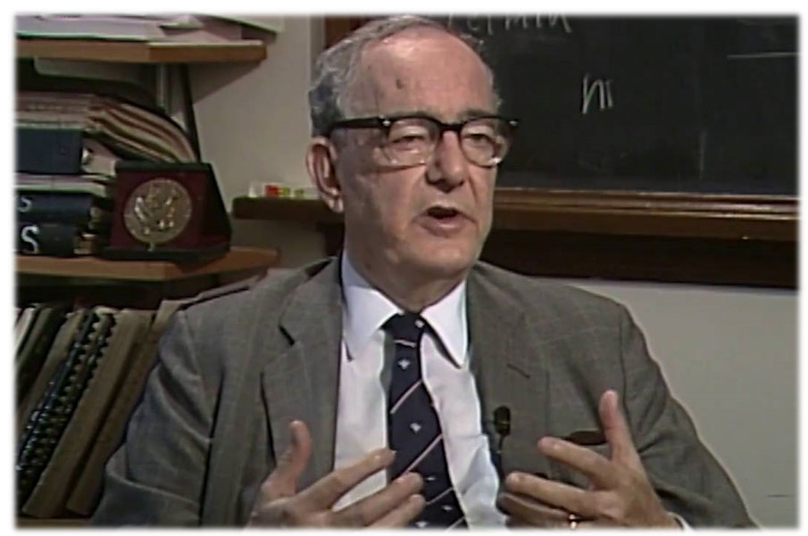
Simon Says
Notes:
Herbert A. Simon was one of the founders of cognitive science. He was a Nobel Laureate who held joint appointments in psychology and computer science at Carnegie Mellon University. Here’s what Dr. Simon had to say about learning.

Slide 4
It’s All About You
Learning results from what the student does and thinks
and only from what the student does and thinks.
The teacher can advance learning only by influencing what the student does to learn.
–Herbert A. Simon
Notes:
Learning results from what the student does and thinks
and only from what the student does and thinks.
The teacher can advance learning only by influencing what the student does to learn.
In other words, your professors can help you and guide you, but learning is entirely up to you.
What can you do to enhance your learning? Interacting with the material multiple times is a key technique.

Slide 5
A Key to Learning
Re-use
Psychologists call this “rehearsal.”
Cramming doesn’t work.
At least four times.
Glancing at the material doesn’t work.
Notes:
If you remember one key thing about these best practices remember reuse of information.
Psychologists call this "rehearsal."
The goal of studying is to move material from your short term memory to your long term memory.
To do that you need to use the material at least four times with increasing time periods between exposures.
That means cramming doesn’t work; you have to space out your studying. Doing that will make you less stressed, too.
Simply glancing at the material doesn't work. You must actually use and think about it, relating new information to what you already know to form associative cues, which is why psychologists call this rehearsal.
The following information about learning is necessarily highly simplified. The purpose is to explain why you should do these things and not to be a study of memory models.

Slide 6
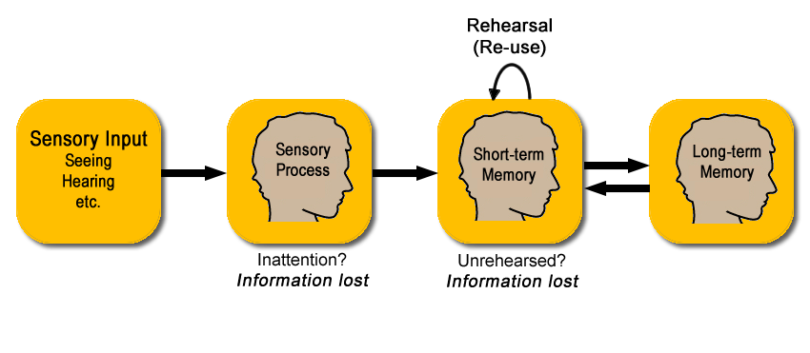
Atkinson-Shiffrin Memory Model
Notes:
Let's look at something called the Atkinson Shiffrin memory model. The model was proposed in 1968 by, as you might expect, Atkinson and Shiffrin, and changed and enhanced for several years afterward. There are more recent theories of memory and not all psychologists agree about how this works. Even so, this model can help us understand what we need to do to learn effectively.

Slide 7
Atkinson-Shiffrin Memory Model
Notes:
We get a huge amount of input from our senses. For most of us, most of the input comes through our eyes and ears. We don't retain all of it. In fact, most of it is lost immediately.

Slide 8
Atkinson-Shiffrin Memory Model
Notes:
The sensory process in our brains "filters in" those inputs that have our attention and discards the rest. So if you're reading a compelling text message in class what the professor is saying at the time is lost.

Slide 9
Atkinson-Shiffrin Memory Model
Notes:
Those sensory inputs which had our attention are committed to short-term memory. To move information from short-term memory to long-term memory requires rehearsal, that is reusing the information.

Slide 10
Atkinson-Shiffrin Memory Model
Notes:
The capacity of long-term memory seems to be unbounded. Information is returned to short-term memory for use through associative cues such as an exam or quiz question, or a situation that requires information that we've learned previously.
Onward to the best practices!

Slide 11
Engage with Classes
Engage with classes.
Notes:
Attend and engage with your classes. Your classes may be face-to-face or online. It doesn’t matter. You must keep up with the pace of the class. In fact, asynchronous online classes are harder than classes with established meeting times because they require more self-discipline.
In any setting, whether online or face-to-face, you’ll have more and better interactions with your professors and fellow students if you are present and engaged. Attending class is not a decision to make. It’s something that you need to do.

Slide 12
Do the Homework
Engage with classes.
Do the homework.
Notes:
Do the homework. Professors do not assign homework to get the answers. In early every case, the professor already knows the answers. Yes, I’ve made mistakes and assigned problems I didn’t know the answers to, but not very often. The purposes of the homework are to let you practice the things you’re learning and to demonstrate that you know the material. A cut-and-paste homework assignment deprives you of the practice, and might get you a penalty for academic misconduct. While you’re working on the homework, analyze what you think the professor expects you to learn from each part of the assignment and be sure you’re focused on the objective. Is it for proficiency practice? Concept formation? To develop the ability to combine ideas? ... and so on. And remember, you’re likely to find similar material on the exams. So do the homework!

Slide 13
Make Studying a Habit
Engage with classes.
Do the homework.
Find a quiet place and time to study.
Notes:
Find a quiet place and time to study and make studying a daily habit, like working out or practicing music. Studying should be free from distractions. That means put away your phone! Music will distract, too. That’s why they play music in dentists’ offices. If you need to mask distracting sounds try white noise.

Slide 14
Read Assigned Material Before Class
Engage with classes.
Do the homework.
Find a quiet place and time to study.
Read the assigned material before class.
Notes:
If you’re given a reading assignment, do it before class and take notes of the important points. Yes the professor is going to tell you most of it in class or present notes on line, but usually the author of the material and the professor are different people, so you get two points of view on the same material and, if you’re engaged, you get re-use. Don’t promise yourself that you’ll read it later because mostly that doesn’t happen.

Slide 15
In Class, Listen
Engage with classes.
Do the homework.
Find a quiet place and time to study.
Read the assigned material before class.
In class, you should be listening.
Notes:
In class listen instead of messing around with your gear. You may have convinced yourself that you can multitask and still absorb the material. If so, you'd be wrong! A study at Bryan College showed that multitasking during cognitive tasks lowers IQ by 15 points. I don't know about you, but I don't have 15 points to spare.

Slide 16
Ask Questions
Engage with classes.
Do the homework.
Find a quiet place and time to study.
Read the assigned material before class.
In class, you should be listening.
Ask questions.
Notes:
If something you read or something the professor says is unclear, ask! If you have a question about something, probably so do others. Professors appreciate thoughtful questions. Asking helps you, helps the professor, and helps your classmates. If you have a question about material from the reading, hold it until the class reaches that part of the material so that you can ask it in context.

Slide 17
Make Notes on Paper
Engage with classes.
Do the homework.
Find a quiet place and time to study.
Read the assigned material before class.
In class, you should be listening.
Ask questions.
Make notes on paper.
Notes:
In reading or if the professor says something that sounds important, especially if it's not already in the class material or the professor repeats it you, should probably jot that down on paper. Why paper? Professors Pam Mueller at Princeton and Daniel Oppenheimer at UCLA did a study that showed that taking notes on paper is more effective for learning than using a laptop.

Slide 18
Merge Notes the Following Day
Engage with classes.
Do the homework.
Find a quiet place and time to study.
Read the assigned material before class.
In class, you should be listening.
Ask questions.
Make notes on paper.
Merge your notes onto the slides the following day.
Notes:
On the day after class, merge your reading notes and the class notes onto the printed slides or class material. The first time I told the class that, some people just got irate, and asked, “Why should we do extra work when we could just take notes on the slides?”
First, if you bring printed notes to class, you’ll find them a distraction from what the professor is saying. Second, think about what you’re trying to do. You’re trying to move information from short-term memory into long-term memory, and what does that is re-use of the information, spaced out in time. So when you take those notes from the previous day and copy them onto the slides, you’ve re-used the information. You’ve done some of that work that it takes to move information from short-term memory to long-term memory. Remember, waiting a day helps space things out to improve learning.

Slide 19
Review Last Week’s Material
Engage with classes.
Do the homework.
Find a quiet place and time to study.
Read the assigned material before class.
In class, you should be listening.
Ask questions.
Make notes on paper.
Merge your notes onto the slides the following day.
Each class day, review the material and notes from the class one week ago.
Notes:
Each class day, review the class material and your notes from the class one week ago, and review the assigned reading. That spaces out exposure even further and gives you another round of re-use for moving things from short-term memory to long-term memory.

Slide 20
Learn from Graded Material
Engage with classes.
Do the homework.
Find a quiet place and time to study.
Read the assigned material before class.
In class, you should be listening.
Ask questions.
Make notes on paper.
Merge your notes onto the slides the following day.
Each class day, review the material and notes from the class one week ago.
Learn from graded material.
Notes:
After you get back each graded assignment, homework, or test, look at the work you missed to sure you understand the answer that was expected and ask yourself what was lacking in your studying regimen that made you miss that item. If necessary, adjust your studying regimen.

Slide 21
Best Practices
Engage with classes.
Do the homework.
Find a quiet place and time to study.
Read the assigned material before class.
In class, you should be listening.
Ask questions.
Make notes on paper.
Merge your notes onto the slides the following day.
Each class day, review the material and notes from the class one week ago.
Learn from graded material.
Notes:
If you follow these best practices,
Engage with your classes,
do the homework,
study at the same time and in a distraction-free place,
read the assigned material before class,
listen in class,
ask questions,
take notes in class,
merge the notes onto the material the professor provides,
study your merged notes a week later,
and learn from the graded material,
you’ve gotten four or maybe five licks at the material without really doing very much work other than what you should have been doing anyway. By dividing it up into chunks, you stand a much better chance of remembering it at least until the exam, and maybe even remembering it long enough to use in your career. This works in every class that you take. If you do this, you will learn more and, as a side benefit, maybe make better grades.

Slide 22
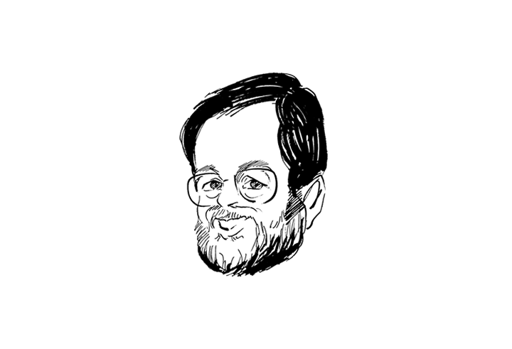
Ten Best Practices for Academic Success
Bob Brown, Ph.D.
College of Computing and Software Engineering Bob.Brown@Kennesaw.edu
Copyright © 2020 by Kennesaw State University Music copyright © 1937 by Warner Bros. Inc.
Notes:
I enjoyed making this video and I hope you found it helpful and useful.
SRT file: Music copyright 1937 by Warner Bros. Inc. and used under fair use principles of U.S. copyright laws.

